Slide 1
Advocacy in Action; Social Workers Supporting LGBTQIA+ Individuals
Dr. Robin Walters-Powell MSW,LISW-S
She/Her Pronouns
Chair of Social Work and Healthcare Services
University of Findlay

Slide 2
Sex, Gender, and Sexuality
Sex: Refers to a person’s biological characteristics such as chromosomes, genetalia, and hormones. These traits are often grouped together as “male” and “female” but do not always naturally occur as such. | Gender: Gender refers to an individual’s identify as woman, man, non-binary, etc. Gender is a personal descriptor and does not need to be based on physical characteristics. Expressions of gender exist in many forms. | Sexuality: Sexuality refers to whoa person is emotionally, sexually, and/or romantically attracted to (or not attracted to). Sexuality exists regardless of gender, but some sexual identities carry gender and/or ex-based implications.

Slide 3
Defining LGBTQIA+
Lesbian
Gay
Bisexual
Transgender
Queer
Intersex
Ally

Slide 5
NASW Code of Ethics
The NASW Code of Ethics emphasizes core values like service, social justice, dignity and the importance of human rights, which are particularly relevant when working with LGBTQIA+ individuals
Social Workers are ethically obligated to not discriminate against individuals based on their sexual orientation, gender identity, or gender expression
Advocacy
Competence and cultural sensitivity
Condemnation of harmful practice
Affirming language

Slide 6
Current Threats
“Don’t Say Gay” Laws (Montana, S458 Erasure)
Restrictions on Drag Performances (2+)
Targeting Transgender Youth (Parental Rights in Education (HB 172)
Transgender Sports Bans (40+)
Banning Gender- Affirming Care for Minors (HB 68)(120+)
Curricular Laws (SB1) (100+)
Bathroom Bills (30+)
Anti-Trans Laws (809 introduced, 40 have passed)

Slide 7
Executive Orders
Eradicating Anti-Christian Bias
Keeping Men Out of Women’s Sports
Ending Radical Indoctrination in K-12 Schooling
Protecting Children from Chemical and Surgical Mutilation
Restoring America’s Fighting Force
Prioritizing Military Excellence and Readiness
Defending Women from Gender Ideology Extremism and Restoring Biological Truth to the Federal Government
Ending Radical and Wasteful Government DEI Programs and Preferencing
Ending Illegal Discrimination and Restoring Merit- Based Opportunity

Slide 9
Risks and Consequences
LGBTQIA+ are at higher risk for experiencing homelessness, HIV and other sexually transmittable infections, substance abuse, violence, family rejection, poor mental and physical health outcomes, incarceration, discrimination, and death (Andersen, Zou, & Blosnich, 2015; Balsam, Rothblum, & Beauchaine, 2005; Bouris, Everett, Heath, Elsaesser, & Neilands, 2015; D’Augelli, Pilkington, & Hershberger, 2002; Frederick, 2014; Pilkington & D’Augelli, 1995; Savin-Williams, 1994; Sterzing, Auslander, & Goldbach, 2014)
These increased risk factors are consistent across the globe and are dramatically increased for female youth and young people of color (Balsam et al., 2015; Button, O’Connell, & Gealt, 2012; Heise, Ellsberg, & Gottmoeller, 2002)
Ultimately such risks are very real and can translate into trauma, anxiety, depression, and other poor mental and physical outcomes for LGBTQIA+ folks (Burton, Marshal, Chisolm, Sucato, & Friedman, 2013; D’Augelli, Pilkington, & Hershberger, 2002; Marshal et al., 2013)

Slide 10
Pronouns
Pronouns exist to streamline language, using simple, one-syllable words to refer to a person instead of their multisyllabic names
We are socialized to understand certain clothing, style, accessories, or mannerisms as attributes of a certain gender, so when we see or meet someone we use pronouns that match our assumptions of gender
For most people this works out just fine, but problems arise when our assumptions of a person’s gender-based pronoun do not match their actual self-identified gender and corresponding pronouns
To know a person’s pronoun:
Ask in a safe and supportive environment, such as a one-on-one conversation.
In groups, include and validate the culture of stating pronouns (e.g., including pronouns in email signatures)

Slide 11
Language as Practice
Social workers are often the stewards of respectful, inclusive language in creating affirming environments for their clients, a role of vital importance for LGBTQIA+ people
How we talk to and about people suggests how we understand them
Language and LGBTQIA+ topics include:
Confidentiality and the expectation of coming out
Learning and validating inclusive language
Understanding pronouns and pronoun usage
Names and identities
Romantic and sexual relationships
Fluidity of identity and impact upon language
Grappling with language and making mistakes

Slide 12
Inclusive Language as Validation
Before speaking to the specifics of language use with LGBTQIA+ folks, it is important to consider the process by which inclusive language is learned and validated
It is important to ask LGBTQIA+ how they would like to be referred to
Doing so must not put the person under a microscope, especially if other people (i.e., peers and adults) are around
Best practice suggests using context clues to make our best guess as to the right course of action, always confirming with the person later if this was in fact the best tactic

Slide 13
Opportunities to Practice Inclusivity
More agencies and organizations are including gender pronouns in their introductions for groups or meetings
For example, co-facilitators may begin a group as follows:
“Hi! My name is Allen and I use he/him/his or they/them/their pronouns.”
Including pronouns in introductions normalizes validating inclusive language for everyone and provides an opportunity to learn pronouns of others
Building an agency culture that learns and validates inclusive language may reduce the anxiety or awkwardness that might emerge when determining how to refer to a person and their relationships

Slide 14
More Opportunities to Practice Inclusivity
One way to do this is by using current events and modeling to demonstrate respectful language
For the first time in U.S. history there are many well-known LGBTQIA+ figures across fields, even in professional sports, and LGBTQIA+-related topics (e.g. marriage, adoption, art, etc.) are more prominent in media and contemporary discourse
This creates the opportunity for social workers to refer to these current events using respectful language, names, pronouns, and discussion when working with clients, especially in group settings with young people
Building an agency culture that learns and validates inclusive language may help to reduce microaggressions

Slide 15
Practice Essentials
Affirming and celebrating self-determination
Social workers must approach all work from the understanding that the client is the expert on their own life
LGBTQIA+ people face significant adversity and it is imperative they not experience it within social work practice(Bonvicini & Perlin, 2003; Crisp & McCave, 2007)
LGBTQIA+ people are socialized to understand the social tensions placed upon their identities and will be sensitive to any approach that does not include them as full, valuable participants of the program
Social workers should affirm LGBTQIA+ individuals self-determination and their unique and diverse identities

Slide 16
Coming Out
LGBTQIA+people may not be interested in coming out to family, friends, or others in their environment
It may be dangerous, painful, or problematic for them to do so
If an LGBTQIA+ person is not interested in coming out, our role is to support them in creating opportunities to reinforce their agency and the confidentiality of their identity
If an LGBTQIA+ appears unaware of the potential for a negative reaction by a family member, caregiver, friend, or environment (e.g., school), it is our role to assist the youth with understanding safety factors and support in not coming out
This may appear to be disempowering or counter-intuitive as practitioners, but in fact may provide safer and more appropriate guidance
Regardless of the reason, it is important to create supportive relationships and environments that respect clients’ decisions regarding others’ knowledge of their sexual and gender identities

Slide 17
Working to Reduce Harm
LGBTQIA+ people experience disproportionate levels of risk vulnerability and complex traumas that impact their mental and physical health
Social workers must recognize that LGBTQIA+ are at higher risk for harm, both external and internal, and work to create practices that are safe, inclusive, and understanding of this harm
Working to reduce harmful and risky behaviors, such as alcohol and substance abuse and/or unprotected sex, must be done in a thoughtful and client-centered way that does not infringe upon the person’s identity or relationships(Adelson, 2012; Duncan, Hatzenbuehler, & Johnson, 2014; Fava & Bay-Cheng, 2013; Leibowitz & Spack, 2011; Pedlow & Carey, 2003).

Slide 18
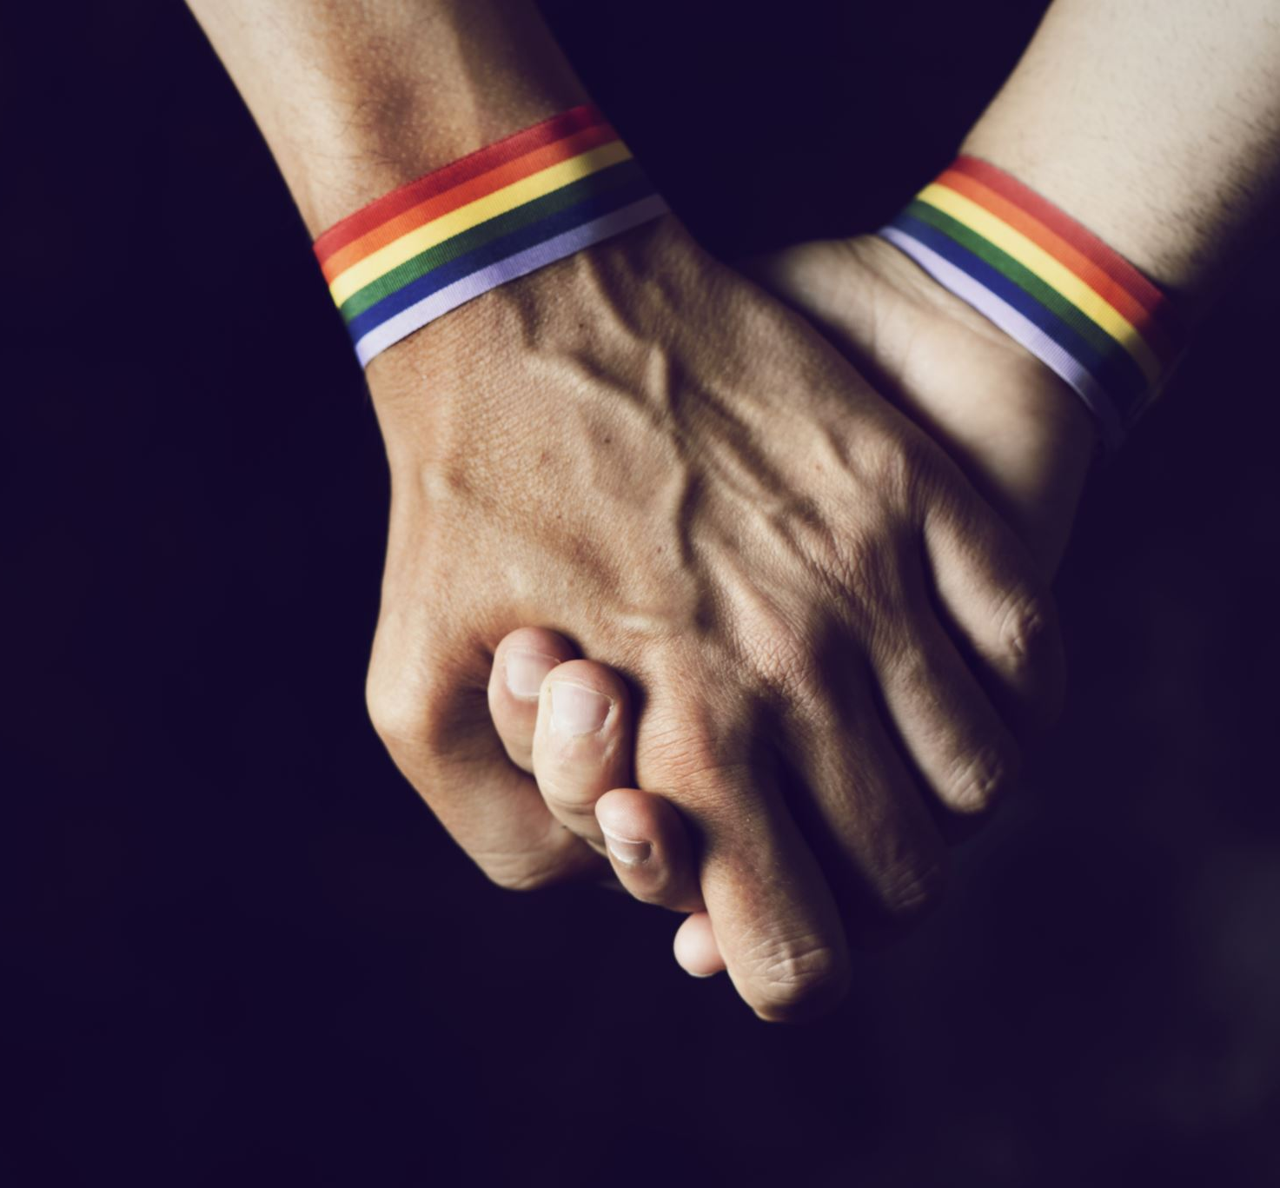
Creating Support
Humans are relational beings; our brains are designed to interact with others and build relationships
LGBTQIA+ folks need supportive peers, adults, health and mental health care systems
Having stable, supportive connections reduce the risks for violence, substance use, poor health, and other outcomes
For LGBTQIA+ youth, who are already more vulnerable to risk and often experience decreased familial support, these connections are vital to achieving positive outcomes throughout life
Mentors, social workers, teachers, coaches, staff members, clinicians, peers, and other supportive relationships create opportunities for LGBTQIA+ to have safe spaces to grow and thrive

Slide 19
Welcoming the Whole Person
LGBTQIA+ individuals are greater than their sexuality, their gender identity, and any prejudice and discrimination they may experience as result of heterosexist, homophobic, and transphobic attitudes, practices, and policies within their social environments
Working with LGTBQIA+ individuals in a group setting provides practitioners with opportunities to welcome the whole person and help them identify and develop narratives of resilience and strength (Malekoff, 2014)
In addition, groups offer practitioners opportunities to harness important therapeutic factors, such as the instillation of hope and universality (Yalom & Leszcz, 2005)
These factors may serve as important protective and/or promotive functions by letting LGBTQIA+ folks know if they are struggling with their identity life does get better and that they are certainly not alone in their struggle

Slide 20
Strengths-affirming social work practice with LGBTQIA+ individuals calls for greater attention to:
Inclusive and validating language,
Affirming practices, policies, and organizational cultures
Understanding and attentiveness to the fluidity of sexual and gender identity development processes for LGBTQIA+ individuals

Slide 21
Your Sphere of Influence
Micro
Educate yourself
Work on reducing harm, using inclusive language, welcome the whole person
Mezzo
Involve yourself in local events, rallies, protests
Educate others on the laws that are being considered or that have passed and find ways to address and support as appropriate
Macro
Involve yourself in broader scale advocacy
Advocacy Day
Call your representatives, let them know your opinions
Attend webinars, trainings, any educational opportunities
Coalition building with the broader community

Slide 22
References
Leibowitz, S. F., & Spack, N. P. (2011). The development of a gender identity psychosocial clinic: Treatment issues, logistical considerations, interdisciplinary cooperation, and future initiatives. Child and Adolescent Psychiatric Clinics of North America, 20(4), 701–724. doi: 10.1016/j.chc.2011.07.004
Little, J., Hodari, K., Lavender, J., & Berg, A. (2008). Come as you are: Harm reduction drop-in groups for multi–diagnosed drug users. Journal of Groups in Addiction & Recovery, 3(3-4), 161-192. doi: 10.1080/15560350802424845
Malekoff, A. (2014). Group work with adolescents: Principles and practice. New York, NY: Guilford Publications.
Marlatt, G. A. (1996). Harm reduction: Come as you are. Addictive behaviors, 21(6), 779-788.
Marshal, M. P., Dermody, S. S., Shultz, M. L., Sucato, G. S., Stepp, S. D., Chung, T., … Hipwell, A. E. (2013). Mental health and substance use disparities among urban adolescent lesbian and bisexual girls. Journal of the American Psychiatric Nurses Association, 19(5), 271–279. doi: 10.1177/1078390313503552
Millett, G. A., Peterson, J. L., Wolitski, R. J., & Stall, R. (2006). Greater risk for HIV infection of black men who have sex with men: A critical literature review. American Journal of Public Health, 96(6), 1007–1019. doi: 10.2105/AJPH.2005.066720
Mueller, A. S., James, W., Abrutyn, S., & Levin, M. L. (2015). Suicide ideation and bullying among US adolescents: Examining the intersections of sexual orientation, gender, and race/ethnicity. American Journal of Public Health, 105(5), 980–985. doi: 10.2105/AJPH.2014.302391
Nadal, K. L., & Griffin, K. E. (2011). Microaggressions: A root of bullying, violence, and victimization toward lesbian, gay, bisexual, and transgender youths. In M. A. Paludi (Ed.), The psychology of teen violence and victimization (pp. 3–22). Santa Barbara, CA: Praeger.

Slide 23
References
Nadal, K. L., Issa, M.-A., Leon, J., Meterko, V., Wideman, M., & Wong, Y. (2011). Sexual orientation microaggressions: “Death by a thousand cuts” for lesbian, gay, and bisexual youth. Journal of LGBT Youth, 8(3), 234–259. doi: 10.1080/19361653.2011.584204
O’Malley Olsen, E., Kann, L., Vivolo-Kantor, A., Kinchen, S., & McManus, T. (2014). School violence and bullying among sexual minority high school students, 2009–2011. Journal of Adolescent Health, 55(3), 432–438. doi: 10.1016/j.jadohealth.2014.03.002
Parks, C. A., Hughes, T. L., & Matthews, A. K. (2004). Race/ethnicity and sexual orientation: Intersecting identities. Cultural Diversity and Ethnic Minority Psychology, 10(3), 241–254. doi: 10.1037/1099-9809.10.3.241
Pedlow, C. T., & Carey, M. P. (2003). HIV sexual risk-reduction interventions for youth: A review and methodological critique of randomized controlled trials. Behavior Modification, 27(2), 135–190. doi: /10.1177/0145445503251562
Pilkington, N. W., & D’Augelli, A. R. (1995). Victimization of lesbian, gay, and bisexual youth in community settings. Journal of Community Psychology, 23(1), 34–56. doi: 10.1002/1520-6629(199501)23:1<34::AID-JCOP2290230105>3.0.CO;2-N
Poon, L. (2015, September 28). “Ze” or “they”? A guide to using gender-neutral pronouns. Retrieved from http://www.citylab.com/navigator/2015/09/ze-or-they-a-guide-to-using-gender-neutral-pronouns/407167/
Price, M., Higa-McMillan, C., Kim, S., & Frueh, B. C. (2013). Trauma experience in children and adolescents: An assessment of the effects of trauma type and role of interpersonal proximity. Journal of Anxiety Disorders, 27(7), 652–660. doi: 10.1016/j.janxdis.2013.07.009
Quinlivan, K., & Town, S. (1999). Queer pedagogy, educational practice and lesbian and gay youth. International Journal of Qualitative Studies in Education, 12(5), 509–524. doi: 10.1080/095183999235926

