Slide 1
What COVID-19 Taught Us about Mental Health
Dr. Mary E. Daly, LMSW, RN
Associate Professor (Retired)
Phi Alpha National Honor Society Board Member
November 14, 2023

Slide 2
Purpose
Explain the positive and negative impacts of the COVID-19 pandemic on mental health
Explore research on promising campus interventions
Discuss our role in supporting mental health awareness and advocacy in higher education
Review the best practices on campuses with Phi Alpha members

Slide 3
Challenges of the COVID-19 Pandemic
Major stressors people faced during the COVID-19 pandemic and lockdown:
Lack of social interaction
Remote learning with new technology
Working from home
Home schooling & childcare issues
Unemployment & financial distress
Media stories about death tolls
Ongoing uncertainty…
What has this experience taught us about mental health?

Slide 4
We Learned Environment Plays a Huge Role in Mental Health
When our usual activities were taken away—everything from going into the office to socializing in person with friends—most of us noticed a shift in mental well-being.
Disrupted routines and limited activity affected our sleep, appetites and general sense of well-being.
We learned our surroundings and interactions matter to mental health (9, 16).
Notes:
Mental Health Is a Continuum
The pandemic taught us that you aren’t either “mentally healthy” or “mentally ill.” Mental health is a wide spectrum and where we fall on that spectrum varies from day to day—or sometimes hour to hour. You might have noticed that your mental health slipped a bit during more stressful times. Even if you didn’t qualify for a diagnosis of depression, anxiety, or some other mental illness, your mental health might not have been as good as it could be. Anything from watching the news to attending online meetings may have greatly impacted how you felt. And you may have become more aware of your mental health more than ever before

Slide 5
We Tried a Variety of Coping Skills
Most people’s “go-to” coping activities were suspended.
Gyms closed, social gatherings were discouraged, and large family events canceled.
Many people sought other positive coping skills, like online yoga practice, knitting or reading books in a cozy chair.
We learned that when you can’t access your usual coping tools a variety of activities can help us manage our emotions and deal with stress or lack of social interaction (9,16).

Slide 6
We Gained New Appreciation for the Outdoors
Outdoor spaces, such as backyards and community parks, offered a socially-distanced reprieve from being cooped up indoors.
Maybe you tried gardening, hiking, cycling or fishing as a new hobby.
An APA article titled "Nurtured by Nature" explains how time spent in nature is healing. It can improve our cognition and mental health. The benefits include improved attention, lower stress, better mood, and reduced risk of mental health disorders (9,16,18).

Slide 7
We Fought Stigma with Mental Health Awareness
The COVID-19 pandemic helped inspire more conversations about the importance of mental health. Celebrities, athletes, and everyday people used social media to discuss the impact on their psychological well-being.
We learned that individuals, families, employers, and communities can help offer support to people when they need it.
Advocacy increased for the importance of self-care, therapy, and help for those with mental health conditions.
Hopefully, increased awareness leads to less stigma associated with seeking mental health care and therapy (9,16).

Slide 8
Some Coping Mechanisms were Not Positive – Substance use increased during the pandemic (1).

Slide 9
Reflections Two Years Post-Pandemic?
According to the CDC (2023), the unprecedented Covid pandemic and lockdown highlighted our stress response to isolation and the importance of social connection (13).
Anyone can feel lonely, but some people may have a harder time connecting with others, including those with poor physical or mental health or financial insecurity; those who live alone, or identify as LGTBQ+ (3)
Disparities in rates of illness, mental health, substance abuse and homelessness became exposed (3,5).

Slide 10
College Student Mental Health Post-Pandemic
College students are experiencing all-time high rates of depression, anxiety and suicidality, according to the 2022-2023 Healthy Minds survey (8).
49% of college students have symptoms of anxiety of anxiety disorder; 14% seriously considered committing suicide during the past year (12,15).
U.S. Surgeon General Vivek Murthy called attention to the number of youth attempting suicide, noting the COVID-19 pandemic has “exacerbated the unprecedented stresses young people already faced” (10,11).

Slide 11
College Counseling Centers Overload
College & Universities are struggling to meet Mental Health (MH) needs.
Services have been expanded & counselors hired but staffing falls short of meeting needs (9,10).
Students with mental health diagnoses were already at risk of dropping out before the pandemic.
64% of young adults no longer in college withdrew due to mental health (2).

Slide 12
Comprehensive Mental Health Strategies
2021
National Academies of Sciences, Engineering and Medicine 2021 reported that campus counseling services are a partial answer to improving student well-being (12). High caseloads and turnover in staff are persistent problems.
Nov. 2023
New report from American Council on Education (ACE), November 2023 identifies areas for colleges and universities to prioritize as supportive measures for students and employee's mental health (16).
Notes:
However, ACE researchers believe investing in or restructuring counseling centers is not sufficient. “The student mental health crisis is not just a counseling center issue,” the report says. “It is a campus-wide issue, and higher education cannot hire its way out of it—there are not enough counselors and not enough funds.”

Slide 13
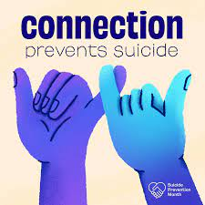
Newer Approaches to College Mental Health
Trauma-informed
Public Health-Informed
Students are more likely to have encountered trauma prior to college OR experienced collective trauma during the COVID-19 pandemic. Behavioral symptoms are a result of coping with past adverse experiences.
Focuses on mental health promotion and risk reduction.
(10,11,16,17)

Slide 14
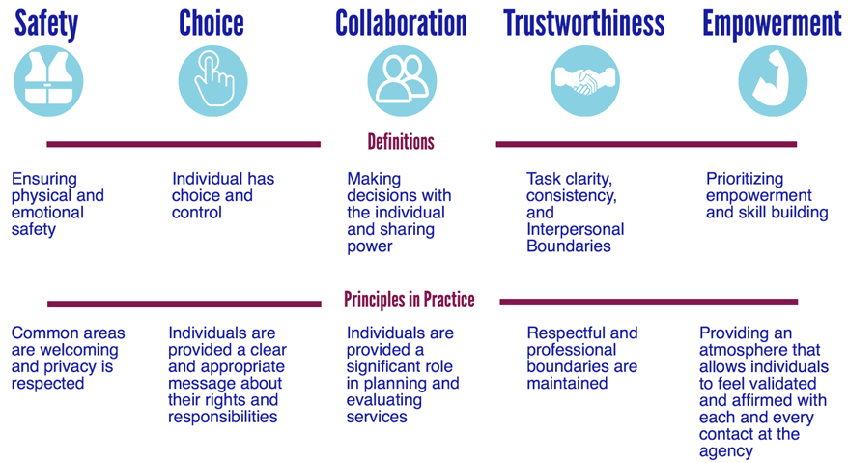
Trauma- Informed Care
Notes:
Trauma- Informed Care:
- cultivating psychological safety
- promoting collaboration & empowerment
- practicing empathy

Slide 15
Public Health-informed Approach
Promote student well-being (prevention), early intervention and treatment. Encourage healthy lifestyle strategies (2,11)
Faculty, coaches & staff as “first responders” who can help identify students in distress. May include taking the Mental Health First Aid course.
Recognize
Respond
Refer (14)

Slide 16
Creative Approaches to Student MH Support
Group support groups promote social connections
Counselor “let’s chat” sessions – increase accessibility
Peer Support Groups – National Alliance for Mental Illness (NAMI) groups
Peer Counseling – provide training in counseling & crisis intervention (10,11,16)

Slide 17
Nurture a Culture of Wellness
Self-Care Plans
Eastern Tennessee University has this a Social Work course assignment. What if all university students had a self-care plan?
Ohio State has a Wellness App to create a plan and share wellness event invites to yoga and other healthy activities (16).

Slide 18
Advocate for College Mental Health Policy
Promote less cumbersome leave of absence policies.
Streamline student’s return to academic program and studies.
Create student-led advocacy groups to fight for mental health resources.
Morehouse College joined with other HBCUs to lobby federal officials for funding (2,11).

Slide 19
Our Mental Health Strategy Post-Pandemic ?
Communities
Social Work Faculty & Students
Self-Care
University Faculty & Students

Slide 20
Service Possibilities for Phi Alpha Chapters
Discussion on Service Projects:
Teaching/mentoring other students in self-care?
Connecting more frequently with other members or chapters?
Promoting awareness or Mental Health First Aid to our campuses?
Providing peer counseling or forming peer support groups?
Advocating for changes related to mental health access and policies?

Slide 21
Self-care Planning for Social Workers – Excerpt from 3/28/23 presentation
Taylor Roberts, BSW, MSW Student Paul Baggett, PhD, LCSW, ACSW

Slide 22
Implications for Social Work Educators & Students
Effective June 1, 2021, the NASW Code of Ethics included “explicit attention to self-care”.
Need to promote and practice self-care as part of ethical practice
Also, includes a statement encouraging macro-systems to “promote policies, practices, and materials to support social workers’ self-care.”

Slide 23
Integrating Self-Care as Ethical Practice
Find ways to multitask with your self-care.
What is something I am already doing that I could incorporate with self-care?

Slide 24
Take your lunch break outside
Listen to music/podcast on your walk to class
Practice mindfulness on your commute to work
Stretch while watching Netflix
Stand while working at your desk
Practice mindfulness before meals
Set a timer on phone to stretch
Refill the water every time you go to the bathroom, even if it is not empty
Take a deep breath every time you step outside
Implement a no phone zone during your lunch or commute to class/meetings
Take the stairs instead of the elevator
Say one self-affirmation after first sip of coffee in the morning

Slide 25
Self-care plan
Identify
Identify areas of stress that you: (1) are currently experiencing and/or (2) anticipate encountering this semester.
Create
Create specific and measurable action steps. Examples:
Stressor: Unhealthy diet
Stressor: Feeling discouraged
Enter
Enter the activities in your daily planner.

Slide 26
Simplest Self-Care: Breathe for Stress Relief!
(4)

Slide 27
Thank You!

Slide 28
References
Agovino, T. October 2, 2021. The COVID-19 Crisis Has Brought Substance Abuse to Light. https://www.shrm.org/hr-today/news/all-things-work/pages/covid-19-brought-substance-abuse-to-light.aspx
American Psychological Association. October 2022. Student Mental Health is in Crisis. Campuses are rethinking their approach. https://www.apa.org/monitor/2022/10/mental-health-campus-care
Association for Psychological Science (2021). Mental Health in a Global Pandemic: Lessons Learned From Psychology. https://www.psychologicalscience.org/publications/observer/obsonline/mental-health-in-a-global-pandemic.html
Blanchfield, T. Sept. 22,2022 Breathe for Stress Relief. https://www.verywellmind.com/the-benefits-of-deep-breathing-5208001
CDC Office of Health Equity, June 27, 2023. Prioritizing Minority Mental Health. https://www.cdc.gov/healthequity/features/minority-mental-health/index.html
Fuller, K. July 1, 2022. How COVID Changed Our View of Mental Health. https://www.verywellmind.com/how-covid-19-has-changed-our-mental-health-world-5094093
Grise-Owens, E. & Miller, J. (2021) The New Social Worker. Self-Care A-Z: National Association of Social Workers (NASW) Code of Ethics (CoE) 2021 Updates. https://www.socialworker.com/feature-articles/self-care/national-association-social-workers-nasw-code-of-ethics-2021-self-care/
Healthy Minds National Data Report, 2022-2023. https://healthymindsnetwork.org/publications/
Morin, A. May 21, 2021. Six Mental Health Lessons Learning During Covid 19. https://www.verywellmind.com/mental-health-lessons-learned-during-covid-19-5181018

Slide 29
References
Mowreader, A. November 7. 2023. Report: Where Higher Ed Needs to Invest in Mental Health. https://www.insidehighered.com/news/student-success/health-wellness/2023/11/07/six-considerations-next-gen-college-student-mental
National Academies of Sciences, Engineering, and Medicine. 2021. Mental Health, Substance Use, and Wellbeing in Higher Education: Supporting the Whole Student. https://doi.org/10.17226/26015.
National Alliance of Mental Illness. Mental Health in College. https://www.nami.org/Your-Journey/Kids-Teens-and-Young-Adults/Young-Adults/Mental-Health-in-College
National Center for Chronic Disease Prevention and Health Promotion, March 21, 2023. https://www.cdc.gov/emotional-wellbeing/social-connectedness/index.htm
National Council for Mental Well-being. (2023) Mental Health First Aid. https://www.thenationalcouncil.org/our-work/mental-health-first-aid/
Newport Institute. November 12, 2022. Depression in College Students: New Statistics and Research. https://www.newportinstitute.com/resources/mental-health/depression-on-college-campuses
Ordway, D-M. September 13, 2023. Improving college student mental health: Research on promising campus interventions. https://journalistsresource.org/education/college-student-mental-health-research-interventions/
University of Buffalo. ND. What is Trauma-Informed Care? https://socialwork.buffalo.edu/social-research/institutes-centers/institute-on-trauma-and-trauma-informed-care/what-is-trauma-informed-care.html
Weir, K. April 1, 2020. Nurtured by nature - American Psychological Association (APA). https://www.apa.org/monitor/2020/04/nurtured-nature
Weisman, S. August 4. 2021. New Mental Health Investments, Ongoing Uncertainties https://www.insidehighered.com/news/2021/08/05/colleges-expand-mental-health-offerings-ahead-fall-semester

